Slide 1

Module 5: Reading and Writing Data
DS 522 Data Acquisition and Analytics

Slide 2
AGENDA
Reading and Writing Data in Text Format
Interacting with Web APIs

Slide 3
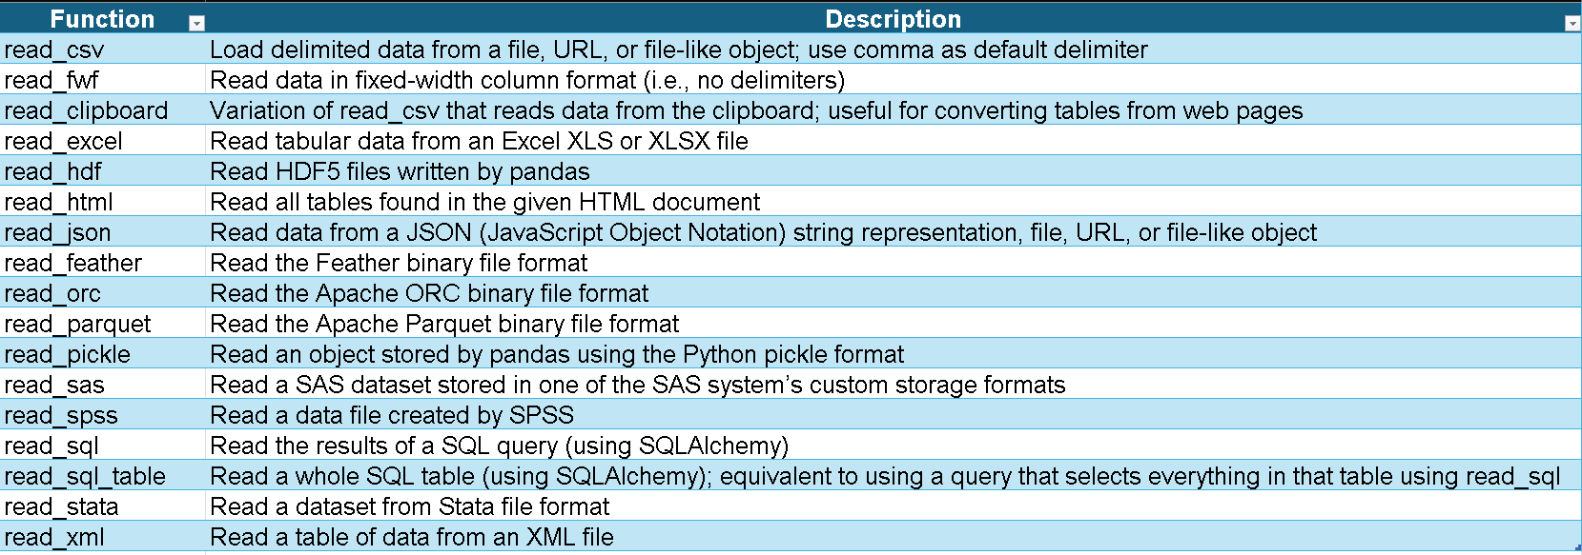
Reading and Writing Data in Text Format
Pandas provides functions for reading tabular data as a DataFrame object.
read_csv – commonly used function

Slide 4
Reading and Writing Data in Text Format
CSV, TXT, JSON

Slide 5
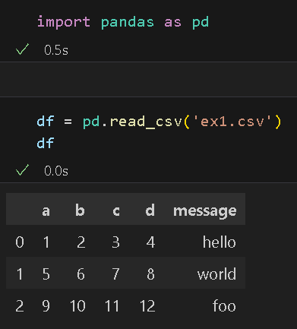
READING AND WRITING DATA IN TEXT FORMAT
Let’s consider the following comma-separated csv text file in examples/ex1.csv:
a,b,c,d,message 1,2,3,4,hello 5,6,7,8,world 9,10,11,12,foo
pd.read_csv - read csv files into a DataFrame.

Slide 6
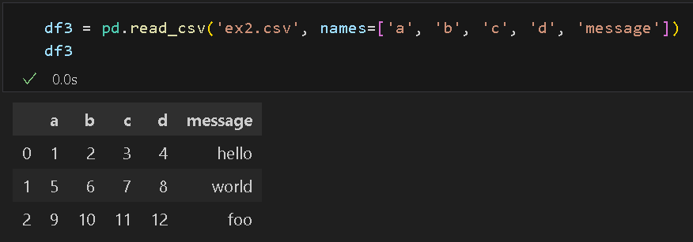
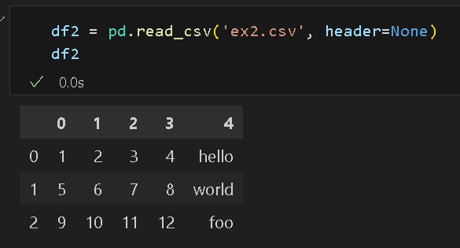
Reading and Writing Data in Text Format
Use pd.read_csv(header=None) for file without a header: examples/ex2.csv
1,2,3,4,hello 5,6,7,8,world 9,10,11,12,foo
Read and include column names:

Slide 7
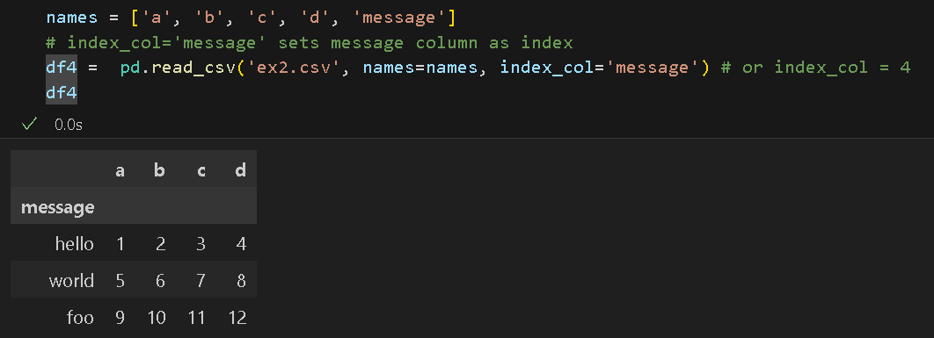
Reading and Writing Data in Text Format
index_col – argument that sets DataFrame column as the index
Example: Set “message”columnas the index

Slide 8
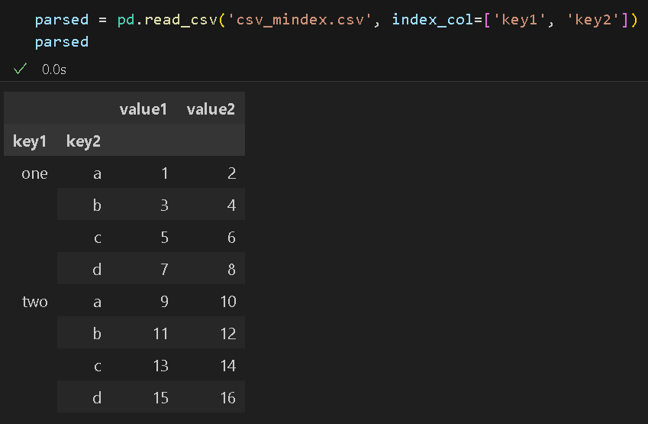
Reading and Writing Data in Text Format
Forming a hierarchical index from multiple columns.

Slide 9
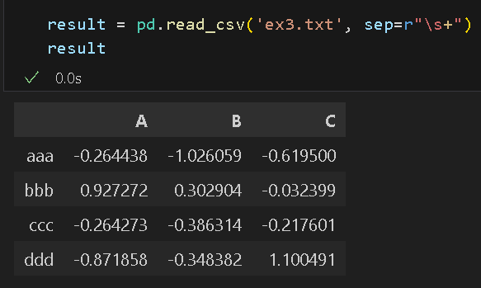
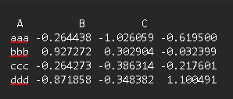
Reading and Writing Data in Text Format
Table with complex delimiter using whitespace or some other patterns.
Example: ex3.txt

Slide 10
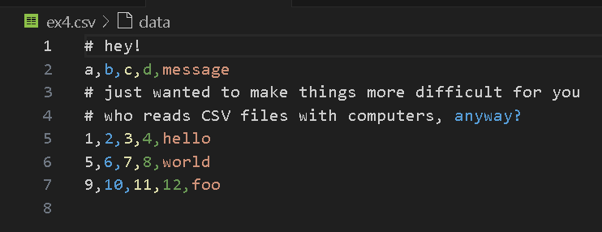
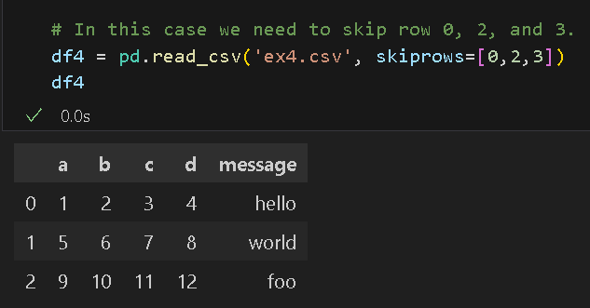
Reading and Writing Data in Text Format
The parser functions have additional arguments to handle a variety of exception file formats.
Example: ex4.csv - skip certain rows using skiprows.
In this case we need to skip row 0, 2, and 3.

Slide 11
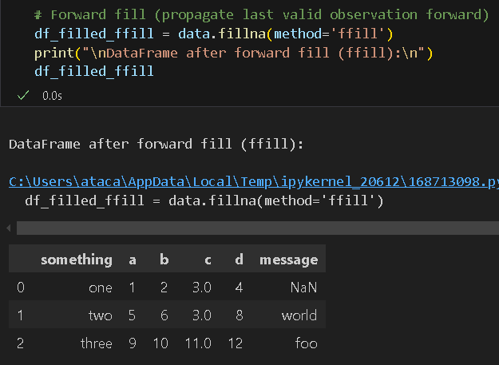
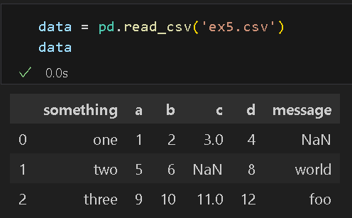
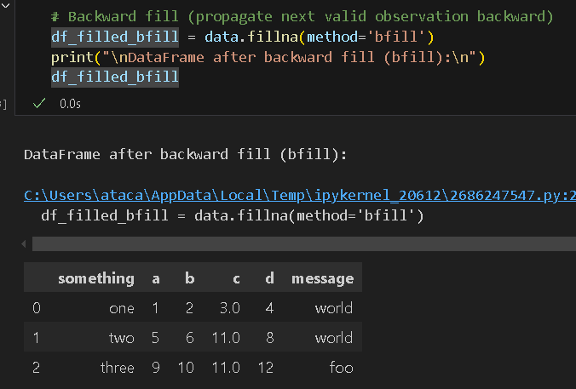
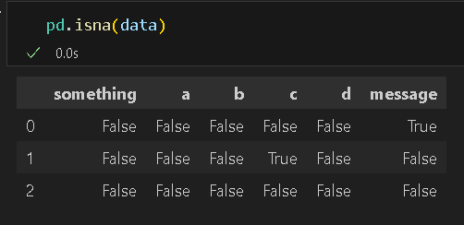
Reading and Writing Data in Text Format
Handling missing values – replace them with other values
Example: ex5.csv
Check for NaN/Null

Slide 12
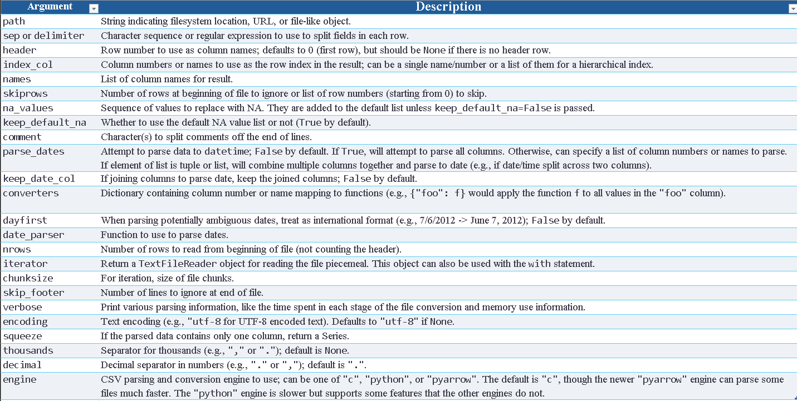
Reading and Writing Data in Text Format
Table 6-2 lists operations used frequently in pandas.read_csv.

Slide 13
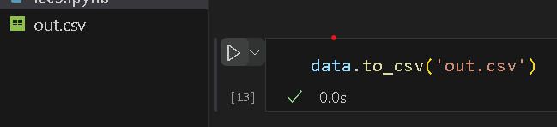
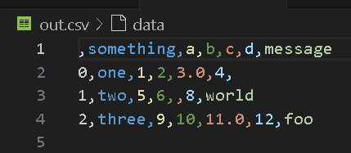
Writing Data to Text Format
Data can be exported to a delimited format (e.g. csv format)
Example: ex5.csv
Use .to_csv() method to write data into a comma-separated file: ​

Slide 14
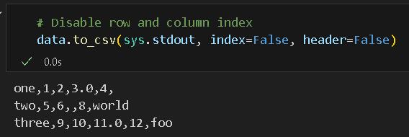
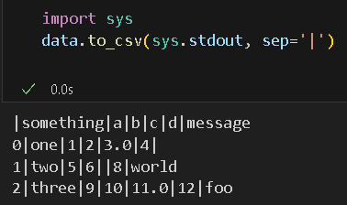
Writing Data to Text Format
Using other delimiters: sep=‘|”
Use sys.stdout to print the result to the console:
Disable row and column labels.

Slide 15
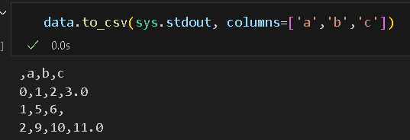
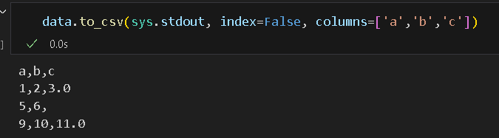
Writing Data to Text Format
Print a subset of columns, in the order we want.
Unless specified, both the row and column labels are shown.

Slide 16
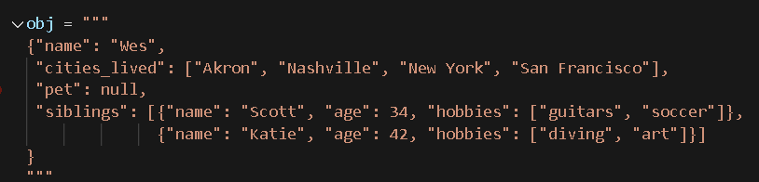
Reading and Writing Data in Text Format: JSON Data
JSON (JavaScript Object Notation) is a standard format for sending data by HTTP request between web browsers and other applications.
Its data format is very flexible compared to a tabular text form like CSV.
Example of a JSON object:
JSON is very similar to Python code except for its null value and some other nuances.
Basic types are objects (dicts), arrays (lists), strings, numbers, booleans, and nulls.
All of the keys in an object are in strings.

Slide 17
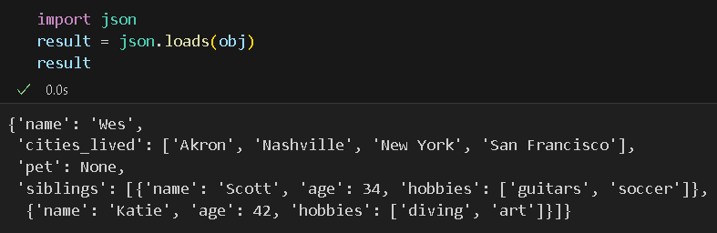
Reading and Writing Data in Text Format: JSON Data
json.loads converts a JSON string to Python form.
json.dumps converts a Python object back to JSON

Slide 18
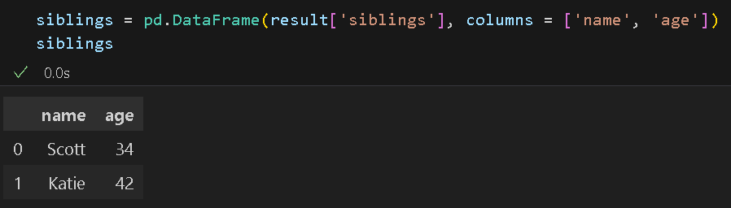
Reading and Writing Data in Text Format: JSON Data
Passing a list of dicts to DataFrame and selecting a subset of the data field
Subset: result[‘siblings’]
and columns [‘name’,’age’]

Slide 19
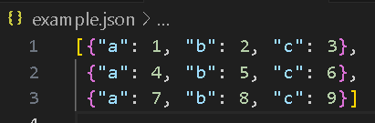
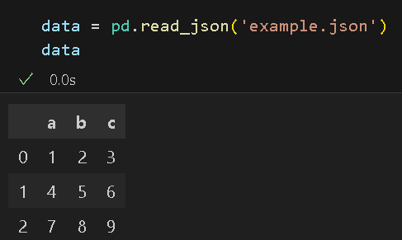
Reading and Writing Data in Text Format: JSON Data
The pandas.read_json can convert JSON datasets in specific arrangements into a Series or DataFrame.
Example: example.json
By default, pandas.read_json assume each object in the JSON array is a row in the table.

Slide 20
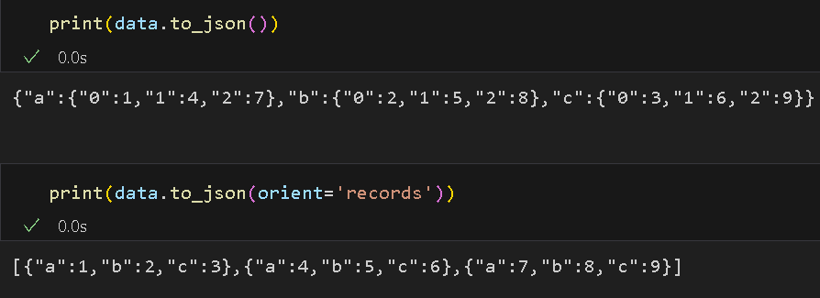
Reading and Writing Data in Text Format: JSON Data
to_json methods - Export data from pandas Series and DataFrame to
JSON

Slide 21
INTERACTING WITH WEB APIs

Slide 22
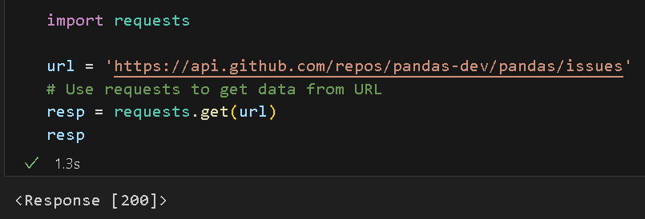
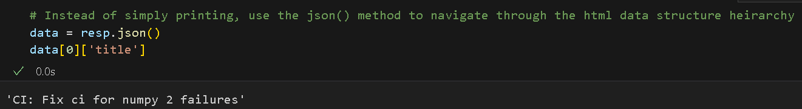
Interacting with Web APIs
Many websites have public APIs that provide data feeds via JSON or some other format.
requests package - easy-to-use method to interact with web APIs.

Slide 23
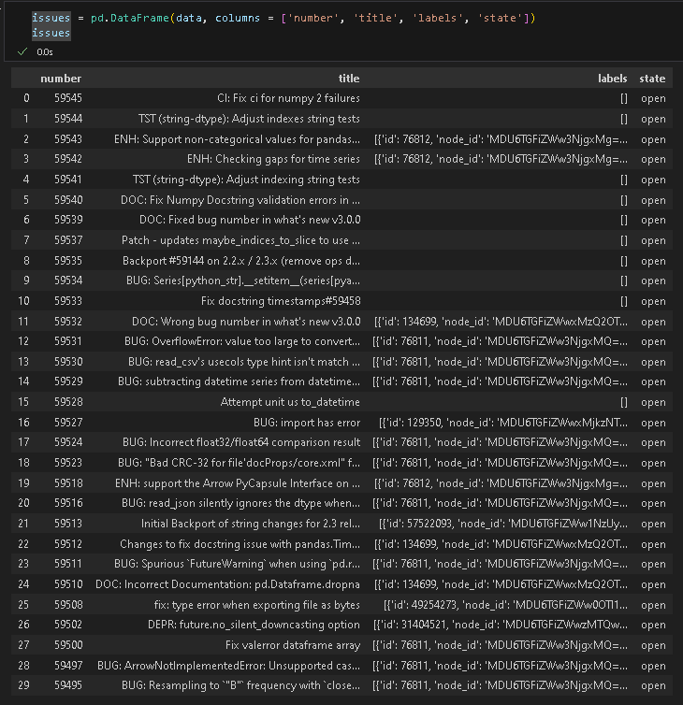
Interacting with Web APIs
Passing data directly to a DataFrame and extract fields of interest.

Slide 24
References
references
McKinney, W. (2022). Python for Data Analysis: Data Wrangling with Pandas, Numpy, and IPython. O’Reilly. (ISBN: 1-0981-0402-1)
McKinney, W. (2022). Python for Data Analysis: Data Wrangling with Pandas, Numpy, and IPython. O’Reilly. (ISBN: 1-0981-0402-1)

Slide 25

Thank you!

